Slide 1
Who Must/Should File?
IRS Pub 17 – Chapter 1
IRS Pub 501
IRS Pub 4012 – Tab A
IRS 1040 Instructions
NJ 1040 Instructions
Notes:
1

Slide 2
Federal and NJ State Filing Requirements are Different
Counselors must reference both Federal and State filing requirements guidelines
A taxpayer may be required to file a Federal Return but not a NJ State Return
A taxpayer may be required to file a NJ State Return but not a Federal Return
Even if a taxpayer is not required to file a tax return, there are cases the return should be filed anyway (e.g. - tax withheld from pay check)
NOTE: IRS guidelines suggest all returns be filed, even if not required. This is to help prevent fraud

Slide 3
Federal Filing Requirements
Pub 4012, Tab A Chart A – Footnotes
Any person born on 1/1 is considered to be born in the prior year for Federal tax purposes
But not for NJ tax purposes
Applies to taxpayer, spouse and dependent
When using chart and calculating gross income, exclude Social Security benefits unless:
married filing a separate return & taxpayer lived with spouse at any time during current tax year OR
½ of Social Security benefits plus other gross income & tax-exempt interest > $25,000 ($32,000 if MFJ)
Must file if not living with spouse at end of current tax year (or on date spouse died) & gross income of at least $4,050 regardless of age
Notes:
3

Slide 4
Federal Return Should Return Be Filed? – Not So Clear
Documents indicate tax return may be necessary:
Enter data in TaxSlayer to decide for sure if Federal and State returns are required or not
If no return is required:
May want to file anyway
If not e-filed, print & write “DID NOT FILE” on taxpayer copy
Update site sign-in sheet to reflect return not filed
If a Federal Return is required but not a NJ 1040, may still want to e-file NJ Return
We can file a Federal Return for anyone in USA
If Federal Return is not required but NJ is required (rare)
Can e-file NJ only
Notes:
TaxSlayer allows you to file:
both Federal & State or
Federal only or
State only return
4

Slide 5
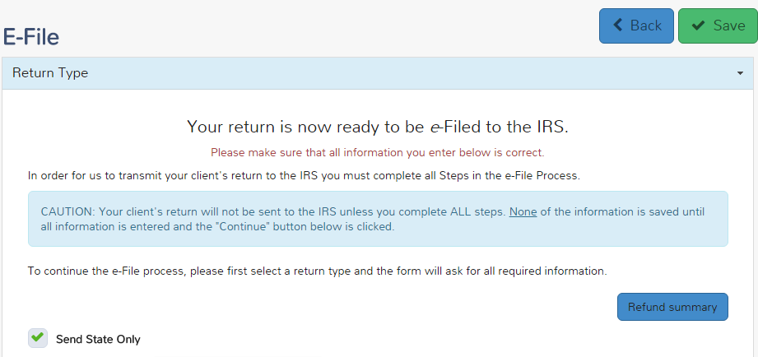
TS - E-File NJ Return Only - e-File section
Click on “Send State Only” to e-file NJ return only

Slide 6
TS - E-File NJ Return Only - e-File section
You will receive a warning if you choose to e-file
NJ return only
You will receive a warning if you choose to e-file a NJ return only

Slide 7
NJ Filing Income Threshold Filing Requirements
NJ 1040 Instructions
If your filing status is… | THEN file a return if your gross income (NJ line 28) was at least..
Single | $10,000
Married/Civil Union Partner filing joint return | $20,000
Married/Civil Union Partner filing separately | $10,000
Head of Household with qualifying child | $20,000
Qualifying widow(er)/surviving Civil Union Partner | $20,000
Notes:
This information is in NJ 1040 Instruction booklet
7

Slide 8
NJ State Return Does Not Have to File
Review of Intake & Interview Sheet & tax documents clearly show that all below apply:
If ALL of the following conditions exist
Income is under filing threshold
No withholdings to be refunded
Homeowner (not a Tenant)
Not eligible for Earned Income Tax Credit (EITC)
Notes:
Tenants who are under the filing threshold should still file to get the $50 property tax credit

